Slide 1
Scientific Writing
Less is more

Slide 2
What is scientific writing?
A quote taken from an interview with Dr. Rick Lombardo:
How is scientific writing different from other kinds of writing?
“Scientific writing is not just writing about science; it is the technical writing that scientists do to communicate their research to others. Scientific writing is predicated on the rigors of scientific inquiry, so it must reflect the same precision as that demanded in the research process.”
Notes:
Interview with Dr. Rick Lombardo from the University of Nebraska-Lincoln: https://www.unl.edu/gradstudies/connections/scientific-writing

Slide 3
How many of you have taken a writing class?

Slide 4
What is the difference between
general writing and scientific writing?

Slide 5
What about
science writing and scientific writing?

Slide 6

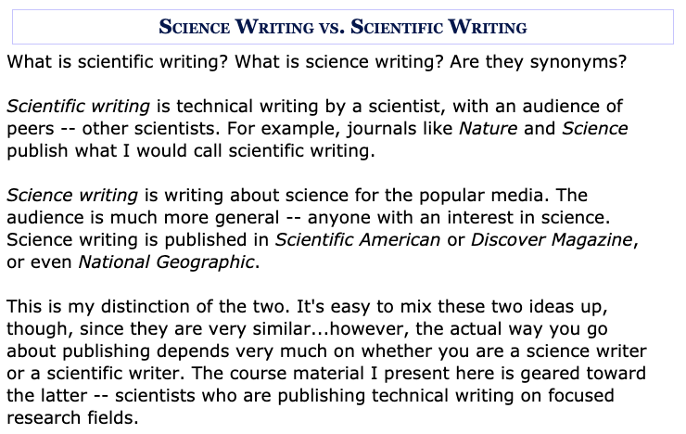
Notes:
https://cgi.duke.edu/web/sciwriting/index.php?action=science_writing

Slide 7
General Writing
Scientific Writing
Flowery and full of descriptions
To the point with limited use of descriptors
Driven by facts, opinions, both, or neither
Driven by data and results
My mom likes it
Peer-reviewed
Students tend to procrastinate writing
Students tend to procrastinate writing

Slide 8

There are some commonalities...

Slide 9
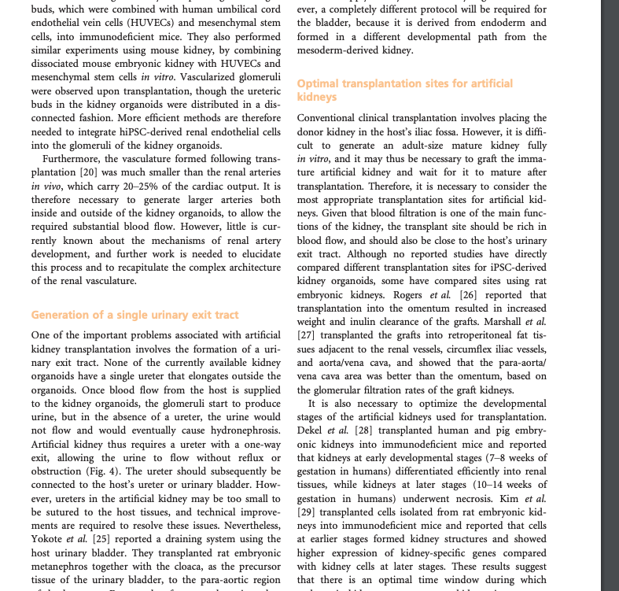
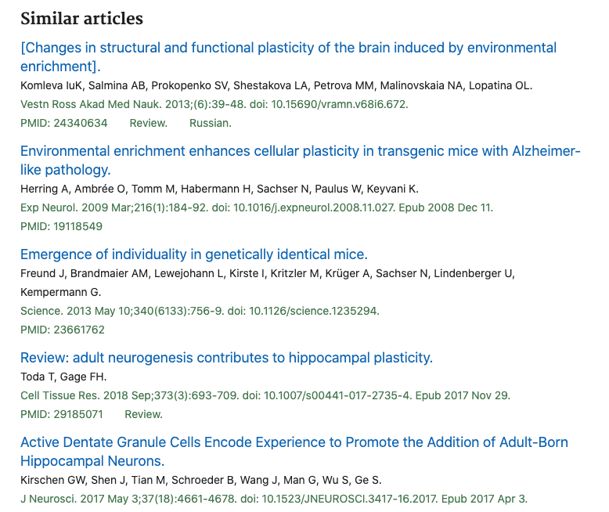
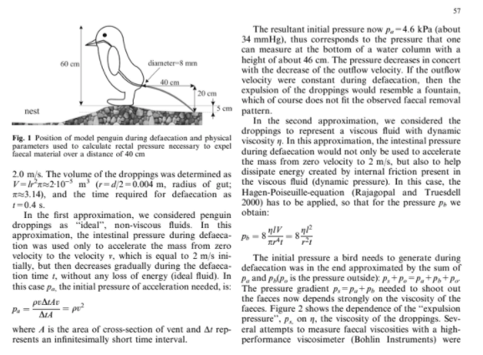
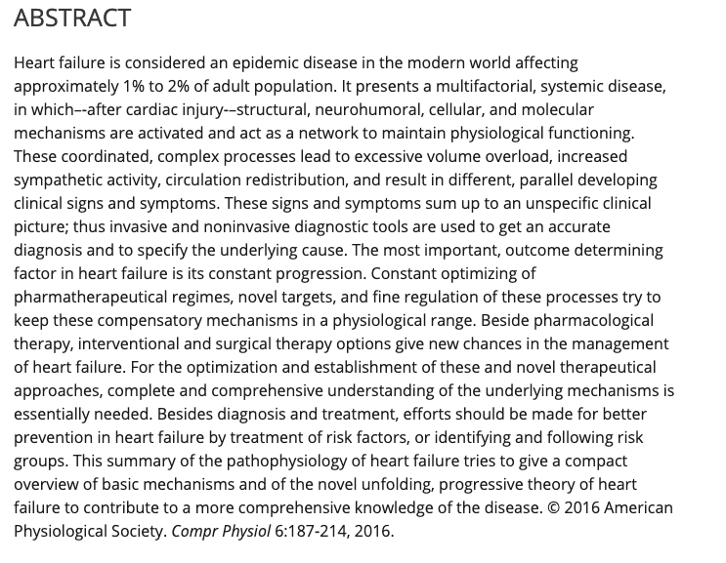
Have your eyes fallen out of your head?kn

Slide 10
Done listening to presentations?

Slide 11
Now it’s your turn to write!
Notes:
What

Slide 12
Make this sentence shorter without changing the facts.
Its small size and the fact that it fluoresces most strongly when bound to components of the cell nucleus make it a nearly ideal cell-wounding probe and therefore a welcome addition to our experimental arsenal.
(35 words)
Its fluorescence when bound to the cell nucleus and small size make it a nearly ideal cell-wounding probe.
(18 words)

Slide 13
Ready for more?

Slide 14
I hoped to find a potential link to the attraction of bees to the leaves they cut versus the leaves that they avoided to cut by analyzing the microbial communities on various leaf pairs I collected. (36 words)
Through our research, we hope to broaden the understanding of the relationship between the behavior of social animals and architecture and continue making an interdisciplinary dialogue into this interaction and how both biologists and architects can ultimately benefit. (38 words)
The overarching goal is to gain a deeper understanding of epileptogenesis and to find ways to improve the lives of children who are identified to have the specific Scn8a gene mutation-- which causes epilepsy-- by reducing epileptic seizures. (38 words)
The hypothesis for this research project is that while thermoacoustic imaging using a microwave to induce temperature change would have stronger penetration of the tissue due to the longer wavelength light, the photoacoustic imaging technique could theoretically provide an image with greater resolution, though at much shallower tissue depths. (49 words)
If the binding affinity between Tm mutations and actin increase then it could lead to cardiomyopathy because tropomyosin will be bound tighter to actin resulting in less movement of tropomyosin on actin that decreases the probability of a strong crossbridge to form between actin and myosin; thus, preventing muscle contraction. (50 words)
Also, this is actually very important because this is a problem that actually limits the materials that can be used because HBN is much cheaper than the other materials so this would mean cheaper technology that is also a lot more reliable since it does not just randomly change energy levels. (51 words)
By exposing the lung to propidium iodide after ventilation and quantitating the number labeled under this condition, it could be shown that the disruptions occurring during ventilation were predominantly not lethal: the number of propidium iodide–positive cells labeled by probe addition after was strikingly decreased compared with probe addition during ventilation. (51 words)
The purpose of this project will be to assess the effects that OVA, an allergen that is known to induce asthmatic effects, has on the dendritic bone marrow cells of mice that have been exposed to various concentrations of Amish house dust, an extract that has been shown to provide protection for children against asthma, ultimately showing the characteristics of the dendritic cells that develop in response to the allergen. (70 words)
Want some more practice?
https://cgi.duke.edu/web/sciwriting/index.php?action=writing_examples

Slide 15

While writing is a critical part of the scientific process, it is often taught secondarily to scientific concepts and becomes an afterthought to students. How many students can you recall who worked on a laboratory assignment or class project for weeks, only to throw together the written report the day before it was due?
For many, this pattern occurs because we focus almost exclusively on the scientific process, all but neglecting the scientific writing process. Scientific writing is often a difficult and arduous task for many students. It follows a different format and deviates in structure from how we were initially taught to write, or even how we currently write for English, history, or social science classes. This can make the scientific writing process appear overwhelming, especially when presented with new, complex content. However, effective writing can deepen understanding of the topic at hand by compelling the writer to present a coherent and logical story that is supported by previous research and new results.

